Slide 1
Inclusiveness (SNIE 1012)
Chapter 1: Understanding Disabilities and Vulnerabilities
Chapter objectives
At the end of this chapter, you will able to:
Define disability and vulnerability
List different types of disabilities and vulnerabilities
Explain a brief causes of disability and vulnerability
Describe the brief historical movements from segregation to inclusion
Describe the effect of attitude on the move towards inclusion
Discuss models of disability
1

Slide 2
INTRODUCTION
1.1 Definitions of Basic Terms
Impairment/የአካል ጉዳተኛ:- a lack/abnormality of an anatomic, physiological or psychological structure or function or deviation on a person.
a physical/mental condition that may limit what a person can do.
a physical/mental disability- a problem, situation/event that makes progress or success difficult
Disability:- the term disability is ambiguous as there is no single agreement on the concept (Mitra, 2006).
Disability is any condition of the body or mind that makes it more difficult for the person with the condition to do certain activities (activity limitation) and interact with the world around them (participation restrictions).
Societal, environmental and systemic barriers are the most popular disabling factors.

Slide 3
Views/approaches about disabilities
Medical Approach- functional limitations due to physical, intellectual or psychic impairment, health or psychic disorders on a person (WHO,1996)
The social approach:- disability largely depends on the context and is a consequence of discrimination, prejudice and exclusion.
How to view Disabilities |  | How to view solutions
Medical model | Social model | Medical model | Social model
Child is faulty | Child is valued | Segregation and alternative services | Resources made available
Diagnosis and labeling | Strengths and needs identified | Re-entry if normal enough or permanent exclusion | Diversity welcomed; child is welcomed
Impairment is focus of attention | Barriers identified and solutions developed | Society remains unchanged | Society evolves

Slide 4
Causes of disability
Genetic Causes:- abnormalities in genes and genetic inheritance e.g. Down syndrome, diseases, illnesses, and over-exposure to x-rays can cause a genetic disorder.
Environmental:- poverty and malnutrition in pregnant mothers as well it can cause poor development of vital organs in the child, which can eventually lead to disability after birth, exposure to certain toxic chemicals and illnesses etc.
Unknown Causes:- humans have still not found all the answers to all the defects in the human body
Inaccessible environments:-sometimes society makes it difficult for people with some impairment to function freely e.g. infrastructure

Slide 5


Slide 6

Types of impairments/Disabilities
Visual impairment:- any kind of vision loss, whether it's someone who cannot see at all or someone who has partial vision loss.
Blindness -vision loss that is not correctable with eyeglasses/lens
Low vision:- partial sight -a visual impairment that affects only central vision—the area directly in front of the eyes—or peripheral vision—the area to either side of and slightly behind the eyes.
Hearing Impairment:- a general term indicating a continuum of hearing loss from mild to profound
Hard of Hearing:- a hearing impairment, whether permanent of fluctuating, which adversely affects a child's educational performance
Deaf:- those who have difficulty understanding speech, even with hearing aids but can successfully communicate in sign language.

Slide 7
Specific learning disability:- a disorder in one or more of the basic psychological processes involved in understanding or in using language, spoken or written.
Specific learning disability manifested in the imperfect ability to listen, think, speak, read, write, spell, or to do mathematical calculations.
The person looks perfectly ―normal and seems to be a very bright and intelligent person, yet may be unable to demonstrate the skill level expected from someone of a similar age.

Slide 8
3.1.Types of Specific Learning Disabilities
Auditory Processing Disorder (APD):- a condition that adversely affects how sound that travels unimpeded through the ear is processed or interpreted by the brain, e.g. affects the interpretation of all sounds.
Dyscalculia:-affects a person‘s ability to understand numbers and learn math.
Dysgraphia:- affects a person‘s handwriting ability and fine motor skills, e.g. illegible handwriting, inconsistent spacing, poor spatial planning on paper, poor spelling, and difficulty composing writing as well as thinking and writing at the same time.
Dyslexia/Language-Based Learning Disability:- affects reading and related language-based processing skills. e.g. can affect reading fluency; decoding, reading comprehension, recall, writing, spelling, and sometimes speech and can exist along with other related disorders.
8

Slide 9

Language Processing Disorder:- difficulty attaching meaning to sound groups that form words, sentences, and stories.
An auditory processing disordered/APD affects the interpretation of all sounds coming into the brain while Language Processing Disorder (LPD) relates only to the processing of language.
Language processing disorder can affect expressive language and/or receptive language.
Non-Verbal Learning Disabilities:- is a disorder that is usually characterized by a significant discrepancy between higher verbal skills and weaker motor, visual-spatial and social skills.
Typically, an individual has trouble interpreting nonverbal cues like facial expressions or body language and may have poor coordination.
Visual Perceptual/Visual Motor Deficit:- a disorder that affects the understanding of information that a person sees, or the ability to draw or copy.

Slide 10
Speech and Language Impairments:- a communication disorder such as stuttering, impaired articulation, language impairment, or a voice impairment that adversely affects a child‘s educational performance.
4.1. Speech Impairments:- articulation disorders, fluency disorders, and voice disorders.
Articulation disorders:- are errors in the production of speech sounds that may be related to anatomical or physiological limitations in the skeletal, muscular, or neuromuscular support for speech production.
*These disorders include; Omissions (bo for boat), Substitutions (wabbit for rabbit), Distortions (shlip for sip)
Fluency disorders:- difficulties with the rhythm and timing of speech characterized by hesitations, repetitions/prolongations of sounds, syllables, words/phrases e.g. Stuttering, Cluttering
Voice disorders:- problems with the quality of one's voice resulting from disorders in the larynx
Characterized by abnormal production and/or absences of vocal quality, pitch, loudness, resonance, and/or duration

Slide 11
4.2. Language Impairments:- includes phonological disorders, morphological disorders, semantic disorders, syntactical deficits, and pragmatic difficulties.
Phonological disorder:- the abnormal organization of the phonological system, or a significant deficit in speech production or perception.
A child with a phonological disorder may be described as hard to understand or as not saying the sounds correctly e.g... d, p, b
Apraxia of speech is a specific phonological disorder where the child may want to speak but has difficulty planning what to say and the motor movements to use.
Morphological disorder:- difficulties with morphological inflections (inflections on nouns, verbs, and adjectives that signal different kinds of meanings) e.g. a particular form, shape, or structure- e.g. plural and singular, conjunction, and so on

Slide 12
Semantic disorders:- characterized by poor vocabulary development, inappropriate use of word meanings, and/or inability to comprehend word meanings.
Syntactic deficits:- characterized by difficulty in acquiring the rules that govern word order and others aspects of grammar such as subject-verb agreement.
Pragmatic difficulties:- a problem in understanding and using language in different social contexts. E.g. understanding of the rules for making eye contact, respecting personal space, requesting information, and introducing topics.

Slide 13
5. Autism:- a developmental disability significantly affecting verbal and nonverbal communication and social interaction, generally evident before age 3 that adversely affects a child‘s educational performance.
Autism is a neurodevelopment disorder defined by impairments in social and communication development, accompanied by stereotyped patterns of behavior and interest (Landa, 2007).
Engaging in repetitive activities and stereotyped movements, resistance to environmental change or change in daily routines, and unusual responses to sensory experiences.

Slide 14
6. Emotional and Behavioral Disorders:- a condition exhibiting one or more of the following characteristics over a long period of time and adversely affects educational performance
An inability to learn that cannot be explained by intellectual, sensory, or health factors;
An inability to build or maintain satisfactory interpersonal relationships with peers and teachers;
Inappropriate types of behavior or feelings under normal circumstances;
A general pervasive mood of unhappiness or depression; or
A tendency to develop physical symptoms or fears associated with personal or school problems.

Slide 15
Classification of behavioral and emotional disorders
Conduct disorder:- seek attention, disrupt and act out (overt -with violence or tantrums) versus covert (with lying, stealing, and/or drug use).
Socialized aggression:- individuals join subculture group of peers who are openly disrespectful to their peers, teachers, and parents (delinquency & dropping out of school)
Attention problems- attention deficit, easily destructible, poor concentration, impulsive
Anxiety/Withdrawn:- self-conscious, reserved, unsure of themselves, anxious, and frequently depressed.
Psychotic behavior:- show more bizarre/strange behavior, hallucinate, deal in a fantasy world and may even talk in gibberish/nonsense.
Motor excess:- hyperactive-cannot sit nor listen to others nor keep their attention focused.

Slide 16
Kauffman (1993) concludes that emotion or behavioral disorders fall into two broad classifications:
Externalizing Behavior:- under-controlled disorder-problems disobedience, disruptiveness, fighting, temper tantrums, irresponsibility, jealousy, anger, attention-seeking, etc…
Internalizing Behavior:- overcontrolled disorders-problems anxiety, immaturity, shyness, social withdrawal, feeling of inadequacy (inferiority), guilt, depression, and worries a great deal

Slide 17
Causes of behavioral and emotional disorders
1. Biological:- includes genetic disorders, brain damage, malnutrition, allergies, temperament, and damage to the central nervous system.
2. Family factors:- family interactions, family influence, child abuse, neglect, and poor disciplinary practices at home.
3. Cultural factors:- traditional and cultural negative practices, for example watching violent and sexually oriented movies and TV programs.
4. Environmental factors:- peer pressure, living in impoverished areas, and schooling practices that are unresponsive to individual needs.

Slide 18
7. Intellectual Disability:- significant limitations in both intellectual functioning and in adaptive behavior, which covers many everyday social and practical skills (before 18)
Criteria for an intellectual disability
Sub-average intellectual functioning:- general mental capacity, such as learning, reasoning, problem-solving, and so on (IQ<70)
Significant limitations exist in two or more adaptive skill areas: such as
conceptual skills:- language and literacy; money, time, and number concepts; and self-direction.
Social skills:- interpersonal skills, social responsibility, self-esteem, gullibility, innocence, social problem solving, and the ability to follow rules/obey laws and to avoid being victimized.
Practical skills:- activities of daily living (personal care), occupational skills, healthcare, travel/transportation, schedules/routines, safety, use of money, use of the telephone.

Slide 19
Impact of Intellectual Disability on individual
General Cognition:- physical and emotional, personality, disposition, and beliefs.
Learning and Memory:- significantly below average in comparison to peers without disabilities
Attention:- difficulty distinguishing and attending to relevant questions in both learning and social situations
Adaptive Skills:- difficulty in both learning and applying skills for a number of reasons, including a higher level of distractibility, inattentiveness, failure to read social cues, and impulsive behavior
Speech and Language:- have delayed speech, language comprehension, and formulation difficulties.
Motivation:- lacking motivation, or outer-directed behavior.
Academic Achievement:- lead to persistent problems in academic achievement
Physical characteristics:- severe & profound intellectual disabilities have multiple disabilities that affect nearly every aspect of intellectual & physical development

Slide 20
Levels and areas of support for intellectual disabilities
Level of support | Duration of support | Frequency of support | Setting of support | Amount of professional assistance
Intermittent/ for mild | Only as needed | Occasional or infrequent | Usually only one or two (e.g. 1–2 classes/activities) | Occasional consultation or monitoring by professional
Limited/ for moderate | As needed, but sometimes continuing | Regular, but frequency varies | Several settings, but not usually all | Occasional or regular contact with professionals
Extensive/ for sever | Usually continuing | Regular, but frequency varies | Several settings, but not usually all | Regular contact with professionals at least once a week
Pervasive/ for profound | May be lifelong | Frequent or continuous | Nearly all settings | Continuous contact and monitoring by professionals
Levels of support for individuals with intellectual disabilities

Slide 21
8. Physical disability/Orthopedic Impairment and Health impairment
Physical disability:- is a condition that interferes with the individual‘s ability to use his or her body.
Many but not all, physical disabilities are orthopedic impairments.
Orthopedic impairment refers to conditions of the muscular or skeletal system and sometimes to physically disabling conditions of the nervous system.
b. Health impairment:- is a condition that requires ongoing medical attention.
It includes asthma, heart defects, cancer, diabetes, hemophilia. HIV/AIDS, etc.

Slide 22
Classification and Characteristics of physical impairment
Mild physical disability:- these individuals are able to walk without aids and may make normal developmental progress.
Moderate physical disability:- individuals can walk with braces and crutches and may have difficulty with fine-motor skills and speech production.
Severe physical disability:-wheel-chair dependent and may need special help to achieve regular development.
Physical disability could be broadly classified into two
The neurological system:- the brain, spinal cord, and nerve-related problems
Musculoskeletal system:- the muscles, bones, and joints deficient

Slide 23

The neurological system
with a neurological condition/problems
1. Cerebral palsy or a traumatic brain injury:- the brain either sends the wrong instructions or interprets feedback incorrectly.
In both cases, the result is poorly coordinated movement.
E.g. with a spinal cord injury/deformity, the pathways between the brain and the muscles are interrupted
In this case messages are transmitted but never received.
The result is muscle paralysis and loss of sensation beyond the point where the spinal cord or the nerve is damaged.
Approximately 40% of those with cerebral palsy have normal intelligence; the remainder/60% have mild to severe retardation
In general, cerebral palsy is a disorder of posture, movement, and non-progression insult/damage of the developing brain

Slide 24
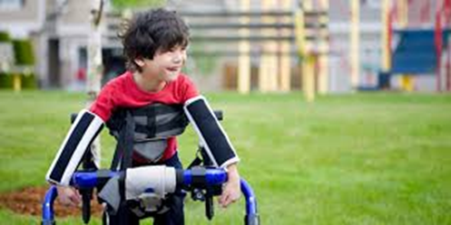
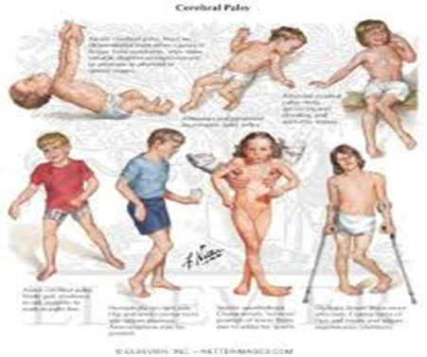

Slide 25
2. Epilepsy:-occurs when the brain cells are not working properly and are often called a seizure disorder.
It is characterized by recurring seizures, which are spontaneous abnormal discharges of electrical impulses of the brain.
If once epilepsy is diagnosed, it can usually be controlled with medication and does not interfere with performance in school.
Most individuals with epilepsy have normal intelligence.

Slide 26
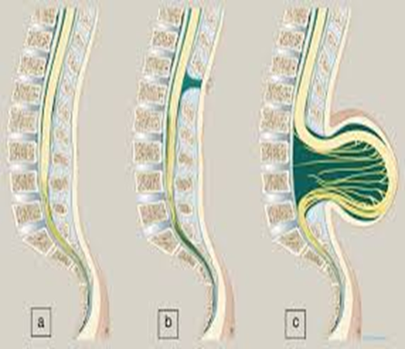
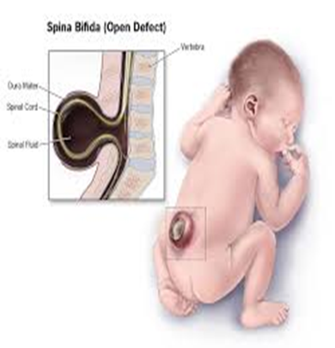
3. Spinal bifida and spinal cord injury:- is a congenital spinal cord injury (spinal column).
The herniated area is associated with injury to the spine & spinal cord
The cause is unknown but it usually occurs in the first 26 days of pregnancy.

Slide 27
Musculoskeletal system
It includes the muscles and their supporting framework and the skeleton
muscular dystrophy (Progressive muscle weakness );
Arthritis (Inflammation of the joints)
Amputation (loss of various parts of the body)
Marfan syndrome (poorly developed muscles and curved spine).
Achondroplasias (straight upper and a curved lower back (sway back))
Polio (paralysis of the body system)
Club foot (ankle or foot deformities)
Cleft lip and cleft palate (openings in the lip or roof of the mouth)

Slide 28
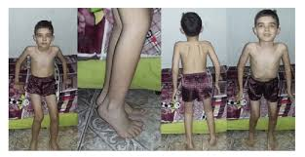
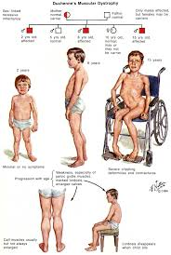
Impairment and associated with musculoskeletal malformation
Muscular dystrophy:- is an inherited condition accruing mainly in males, in which the muscles weaken and deteriorate.
The weakness usually appears around 3 to 4 years of age and worsens progressively.
By age 11 most victims can't longer walk
Death comes 25 and 35 years from respiratory failure or cardiac arrest

Slide 29
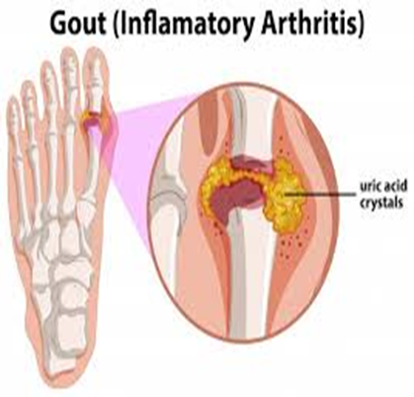
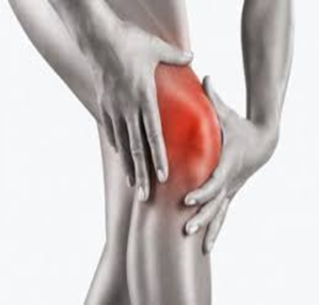
Arthritis:-is an inflammation of the joints.
Symptoms include swollen and stiff joints, fever, and pain in the joints during acute periods.
Prolonged inflammation can lead to joint deformities that can eventually affect mobility.

Slide 30
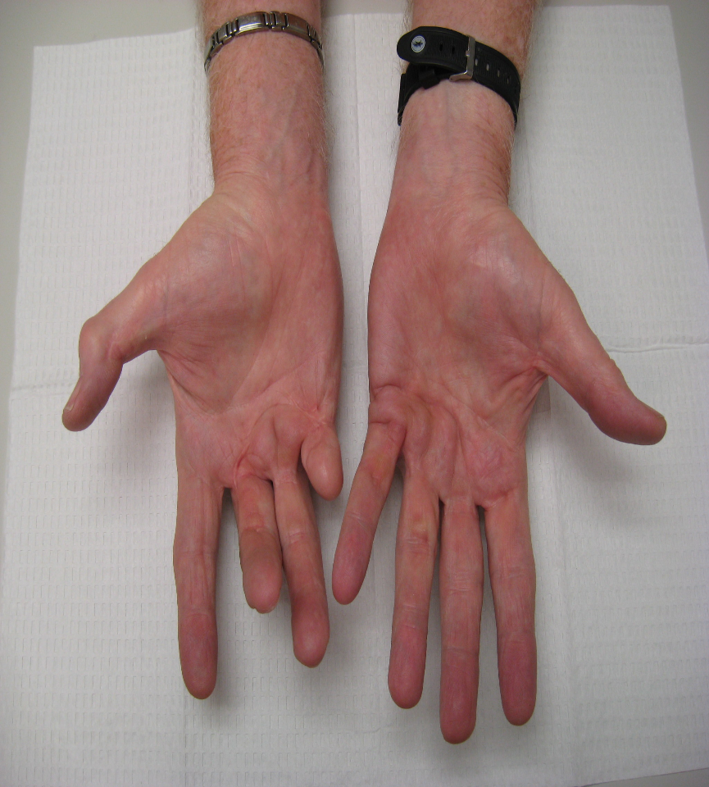
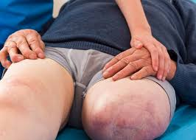
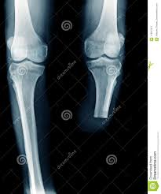
Amputation:- a small number of children have missing limbs because of congenital abnormalities or injury or disease (malignant bone tumors in the limbs).
These children can use customized prosthetic devices (artificial hands, arms, or legs) to replace limp functions and increase independence in daily activities.

Slide 31
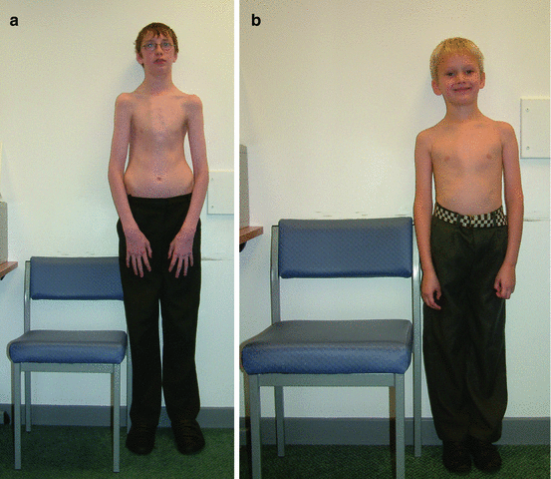
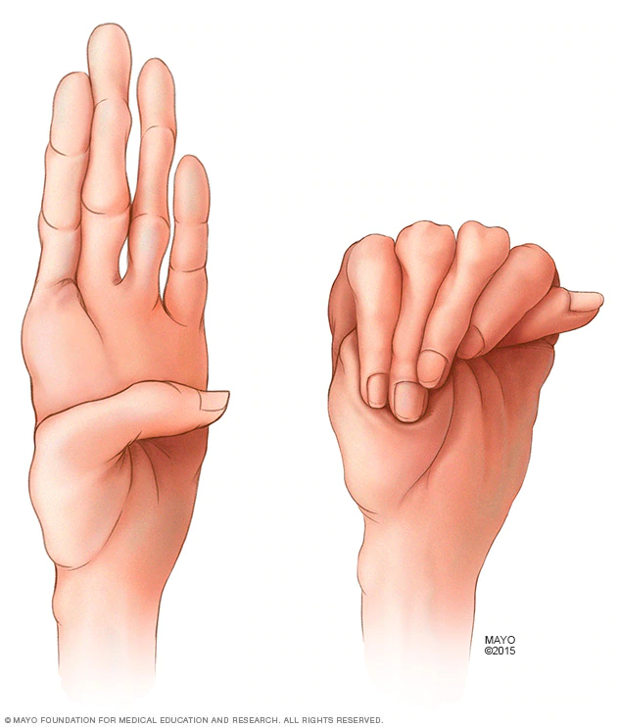
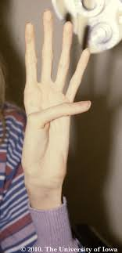
Marfan syndrome:- is a genetic disorder in which the muscles are poorly developed and the spine is curved.
The heart and blood vessels are usually affected.
Individuals with Marfan syndrome need to avoid heavy exercise and lifting heavy objects.

Slide 32
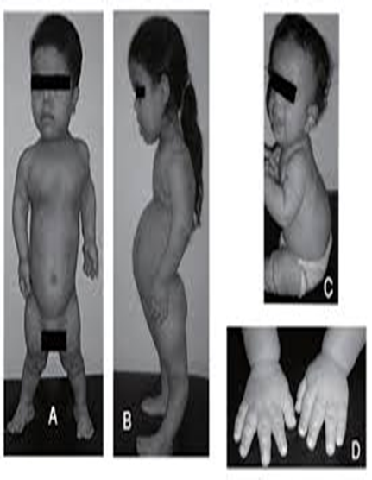
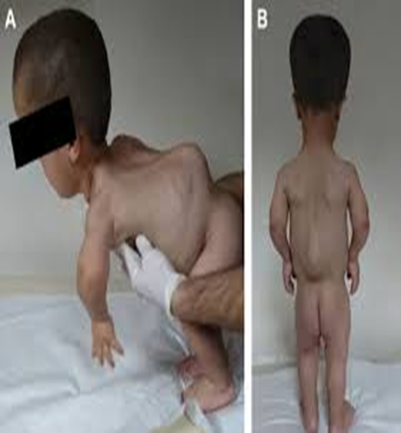
Achondroplasias:- is a genetic disorder that affects 1 in 10,000 births.
Children with this disorder usually develop a normal trunk but have a straight upper back and a curved lower back (sway back).
These children are at risk of sudden death during sleep from compression of the spinal cord interfering with their breathing.
The disability may be lessened through the use of back braces or by surgery.

Slide 33
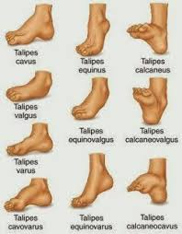
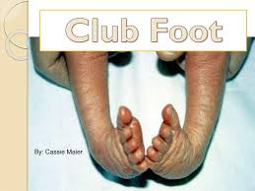
Polio:- is a viral disease that invades the brain and causes severe paralysis of the total body system.
Club foot:- is a major orthopedic problem affecting about 9,000 infants each year. This term is used to describe various ankle or foot deformities, i.e.
Twisting inward (equino varus), the most severe form
Sharply angled at the heel (calcanel vaigus), the most common
The front part of the foot is turned inward.
Club foot conditions can be treated with physical therapy more severe cases, surgery is necessary

Slide 34
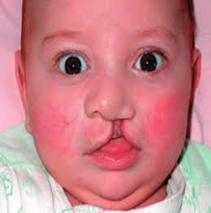
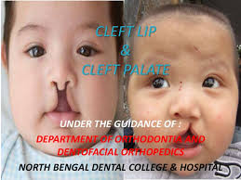

Cleft lip and cleft palate:- are openings in the lip or roof of the mouth, respectively, that fail to close before birth, the cause is unknown.
Most cleft problems can be repaired through surgery.

Slide 35
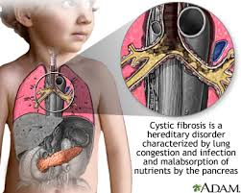
Health Impairments
Heart disease:- caused by the improper circulation of blood by the heart some of the disorders are congenital (present at birth); others are the product of inflammatory heart disease. Some students have heart valve disorders; others have disorders of the blood vessels. this time heart implantation helps children to get cured.
Cystic fibrosis:- this is a hereditary disease that affects the lungs and pancreas.
It leads to recurrent respiratory and digestive problems including abnormal amounts of thick mucus, sweat, and saliva.
The disease is so progressive and few who have it survive beyond age 20.
Children with the such disease often spend
significant time out of school.
Acquired immune deficiency syndrome (AIDS)

Slide 36
Hemophilia:- hereditary disease - the blood clots very slowly/not all. *Transmitted by sex-linked recessive gene and nearly occurs in males.
Asthma:- is a chronic respiratory condition characterized by repealed explode of breathing difficulties, especially while exhaling.
Diabetes: a developmental or hereditary disorder characterized by inadequate secretion or use of insulin
Nephrosis & Nephritis:- Kidney disorders or diseases caused by infections, poisoning, burns, accidents, or other diseases. *Nephrosis is any degenerative disease of the kidney tubules, the tiny canals that make up much of the substance of the kidney. *Nephritis is the inflammation of the kidneys
Tuberculosis:- infectious disease that commonly affects the lungs and may affect other tissues of the body.
Cancer:- abnormal growth of cells that can affect any organ system

Slide 37
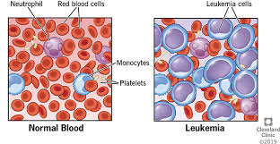
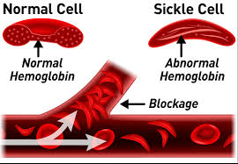
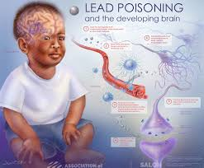
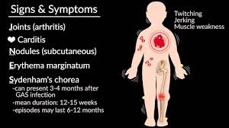


Sickle-cell anemia:- hereditary and chronic blood disease characterized by red blood cells that are distorted and that do not circulate properly
Leukemia:- characterized by excessive production of white blood Cells
Lead poisoning:- disorder caused by ingesting lead-based paint chips or other substances containing lead
Rheumatic fever:- a disease characterized by painful swelling and inflammation of the joints that can spread to the heart and central nervous system.

Slide 38
9. Vulnerability (being at risk of being harmed)
Vulnerability is a complex phenomenon that refers to the following dimensions:
1. Economic difficulties/lack of financial resources:- poverty, low living standards, housing problems (e.g. too damp, too expensive, too cold or difficult to heat), etc.;
2. Social exclusion:- limited access to facilities such as transportation, schools, libraries, or medical services;
3. Lack of social support from social networks:- no assistance from family members, friends, neighbors, or colleagues (referring to practical help as well as emotional support) like highly gifted individuals;
4. Stigmatization:- being a victim of stereotypes, being devalued, confronted with disgraceful behavior because of belonging to a particular social or ethnic group;
5. Health difficulties:- disadvantages resulting from poor mental health, physical health, or disabilities;
6. Being a victim of crime:- in the family context, especially of violence.
««

Slide 39
Causes of Vulnerability
Rapid population growth, poverty and hunger, poor health, low levels of education, gender inequality, fragile and hazardous location, and lack of access to resources and services, including knowledge and technological means, disintegration of social patterns (social vulnerability).
Lack of access to information and knowledge, lack of public awareness, limited access to political power and representation (political vulnerability).
Environmental vulnerability concerns land degradation, earthquake, flood, hurricane, drought, storms, water scarcity, deforestation, and the other threats to biodiversity.

Slide 40
Characteristics of Vulnerable People
Less physically or mentally capable (infants, older adults, people with disabilities)
Fewer material and/or financial resources (low-income households, homeless)
Less knowledge or experience (children, illiterate, foreigners, tourists)
Restricted by society to grow and develop according to their needs and potentials (e.g. the talented and the gifted)
People who are helped by others (who are then restricted by commitments) are still vulnerable people, which includes the following extracted from various researches.

Slide 41
Other groups of people who are helped by others is also considered venerable people
Women: in developing nations and those who are living in rural areas are vulnerable to many backward traditional practices.
Children: are vulnerable and at risk for development (psychological and physical abuse)
Minorities: some people are vulnerable due to their minority background.
Poverty: people are vulnerable to many undesirable phenomena due to poverty.
Disabilities: People with disabilities are very much vulnerable to many kinds of risks.
Age: old people or very young children are vulnerable to all kinds of evils
Illiteracy and less education: People with high rates of illiteracy and lack of quality educational opportunities are vulnerable to the absence of all kinds of developments
Sickness: uncured health problems for example people living with HIV/AIDS are much more vulnerable to psychosocial problems, poverty, and health
Gifted and Talented: gifted and talented children are vulnerable to socio-emotional developments.

Slide 42
Chapter summary questions
How can we educate people with visual and hearing impairments?
What will be the consequences if we do not educate them?
What is your role as an individual and group to create inclusiveness?
Explain a brief cause of disability and vulnerability through evidence by considering some individuals with a disability that you are familiar with.
How can schools create inclusive education for students with physical disabilities as well as for intellectual disabilities?
How can we make inclusion a reality for persons with disabilities in Ethiopia?
What can you do to inclusion in reality as an individual in your respective profession?

